Slide 1

CSE (H) with specialization in Machine Learning and Artificial Intelligence
Soft Computing (CSF – 332)
Chapter -2.1
Introduction to Neural Network Models
By: Dr. Monika Singh E11032
DISCOVER . LEARN . EMPOWER

Slide 2
Course Objectives
To introduce soft computing concepts and techniques of artificial neural networks, fuzzy sets, fuzzy logic and genetic algorithms
To understand the various techniques from the application point of view.
To analyze various soft computing techniques and decide the technique to be used in a particular problem situation.
To implement soft computing based solutions for real-world problems

Slide 3
Course Outcomes
CO1 | Identify and describe soft computing techniques and their roles in building intelligent. Machines | 1
CO2 | Recognize the feasibility of applying a soft computing methodology for a particular problem. | 2,4
CO3 | Apply fuzzy logic and reasoning to handle uncertainty and solve engineering problems, genetic algorithms to combinatorial optimization problems and neural networks to pattern classification and regression problems. | 3
CO4 | Effectively use modern software tools to solve real problems using a soft computing approach. | 3
CO5 | Evaluate various soft computing approaches for a given problem. | 4

Slide 4
Table of Contents
Associative Memory Networks
Bidirectional Associative Memory (BAM)
Hopfield Networks
Self-Organizing Feature Maps: Kohonen Self-Organizing Feature Maps.

Slide 5
Introduction to Neural Network Models

Slide 7
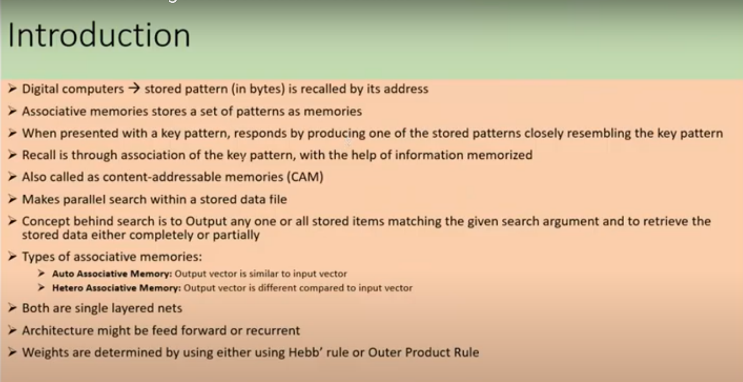

Slide 8
ASSOCIATIVE MEMORY (AM) NETWORK
Two types of associations exist. For two patterns s and t
hetero-association (s != t): relating two different patterns (s – input, t – target).
auto-association (s = t): relating parts of a pattern with other parts.
Architectures of NN associative memory:
single layer (with/out input layer),
Learning algorithms for AM:
Hebbian learning rule and its variations,
Outer Product

Slide 9
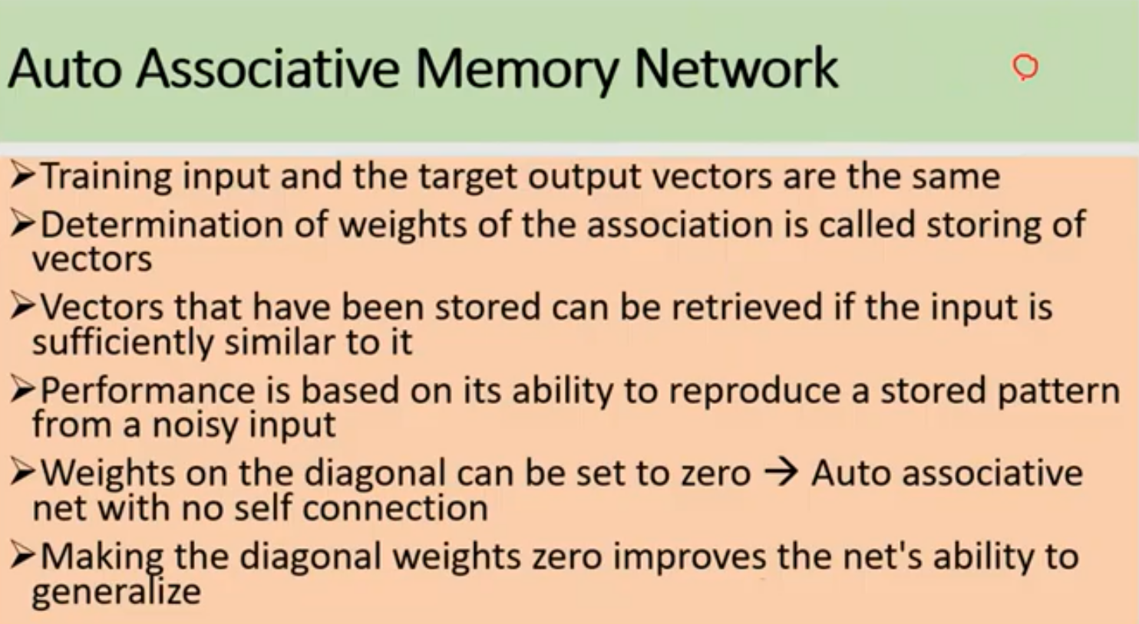

Slide 10
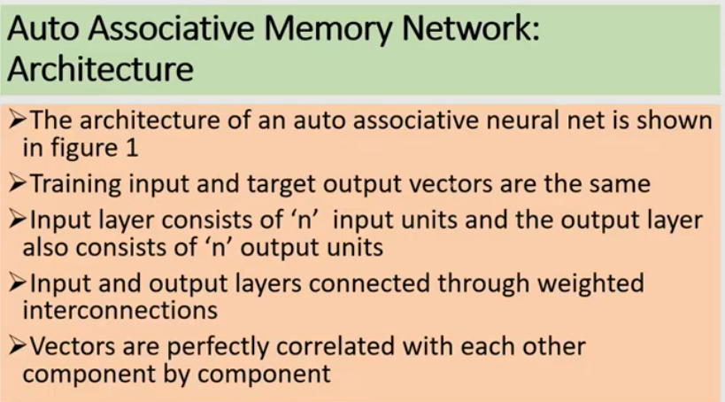

Slide 11
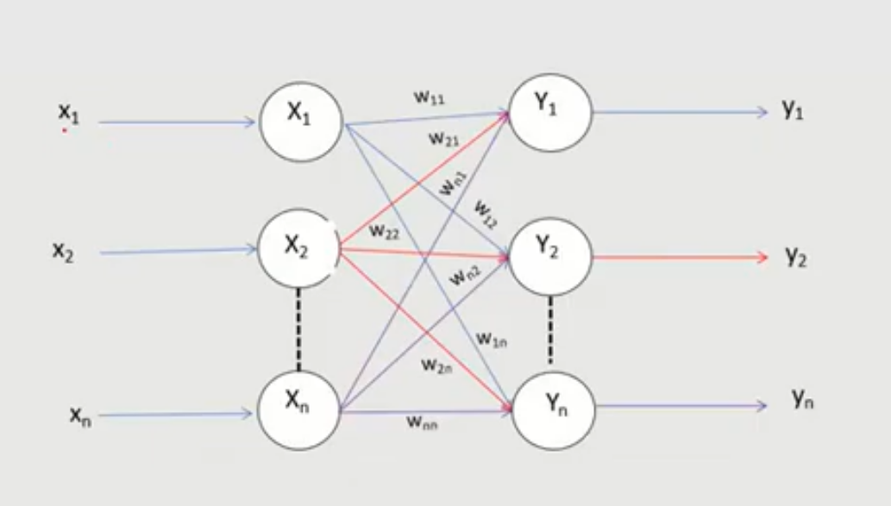

Slide 12
HEBB RULE FOR PATTERN ASSOCIATION
Algorithm (bipolar or binary patterns):
For each training samples s:t:
are ON (binary) or have the same sign (bipolar).
Instead of obtaining W by iterative updates, it can be computed from the training set by calculating the outer product of s and t.

Slide 13
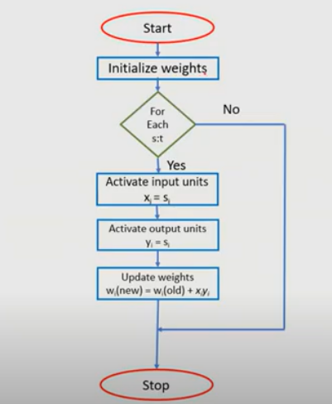

Slide 14
OUTER PRODUCT FOR PATTERN ASSOCIATION
Let s and t be row vectors.
Then for a particular training pair s:t
and

Slide 15
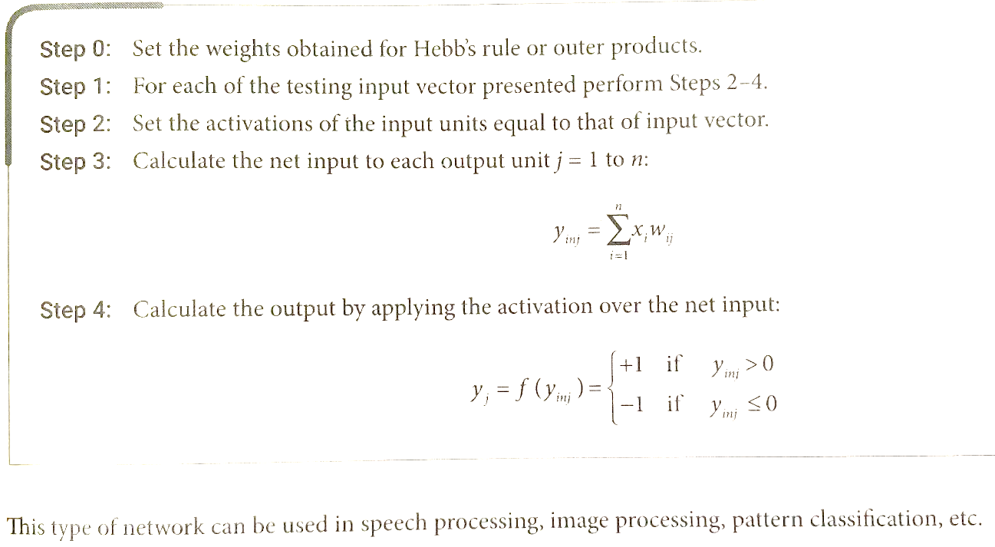
Testing Algorithm

Slide 16
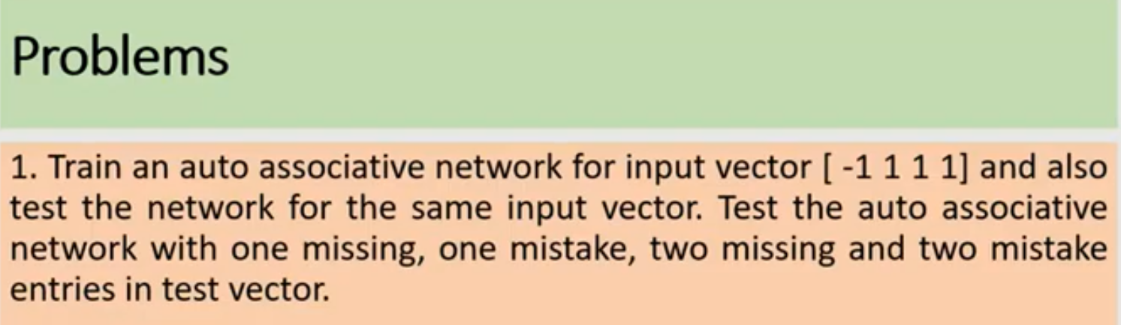

Slide 23
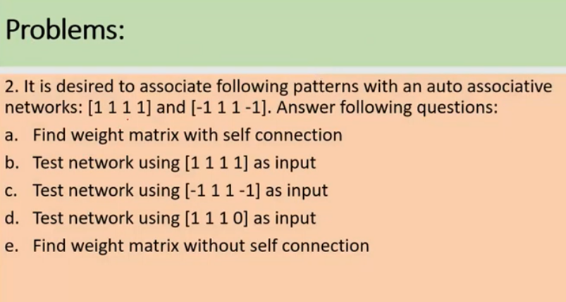

Slide 24
Check autoassociative network for input vector [1 1 -1]. 1. Form weight vector with no self connection. 2. Test the network with one missing entry.

Slide 25
Construct an autoassociative network to store vectors [-1 1 1 1]. Test the network with three missing entries.

Slide 26
Find the weight matrix required to store the vectors [1 1 -1 -1] , [-1 1 1 -1] & [-1 1 -1 1] into W1,W2,W3 resp. Calculate the total weight matrix to store all the vectors and check whether it is able to recognize the same vectors. Let the weight matrix be with no self connection.

Slide 27
Construct the auto-associative network to store vectors [-1 1 1 1]. Use iterative auto-associative network to test the vector with three missing values.

Slide 28
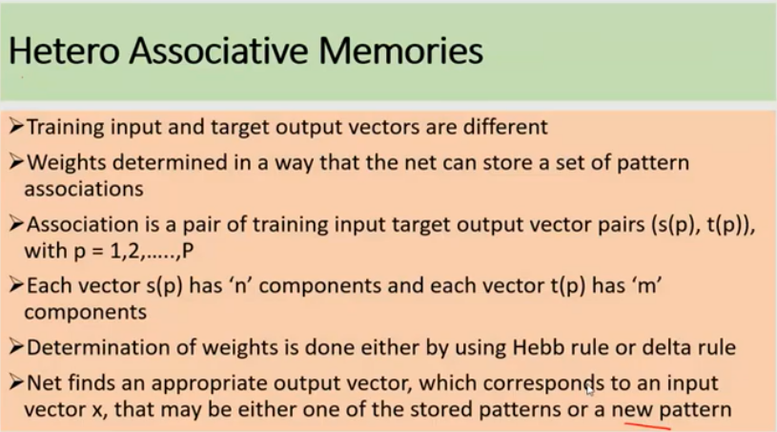

Slide 29
HETERO-ASSOCIATIVE MEMORY NETWORK
Binary pattern pairs s:t with |s| = 4 and |t| = 2.
Total weighted input to output units:
Activation function: threshold
Weights are computed by Hebbian rule (sum of outer products of all training pairs)
Training samples:
s(p) t(p)
p=1 (1 0 0 0) (1, 0)
p=2 (1 1 0 0) (1, 0)
p=3 (0 0 0 1) (0, 1)
p=4 (0 0 1 1) (0, 1)

Slide 30
COMPUTING THE WEIGHTS

Slide 31
TEST/ RECALL THE NETWORK
(1 0 0 0), (1 1 0 0) class (1, 0)
(0 0 0 1), (0 0 1 1) class (0, 1)
(0 1 1 0) is not sufficiently similar to any class

Slide 32
References
“Principles of Soft Computing, 2nd Edition” by S.N. Sivanandam & SN Deepa, Wiley India Pvt. Ltd.
Link :
https://analyticsindiamag.com/6-types-of-artificial-neural-networks-currently-being-used-in-todays-technology/

Slide 33
THANK YOU
For queries
Email: monika.e11032@cumail.in

